Slide 1

LECTURE 4
N AV I G AT I O N , L O C A L S T O R A G E
DANIEL R YS JAN VÁCL AVÍK

Slide 2
O V E R V I E W
Implement movie detail
Get data from API
Mark movie as watched (in Local Storage)

Slide 3
G E T D ATA F R O M A P I

Slide 4

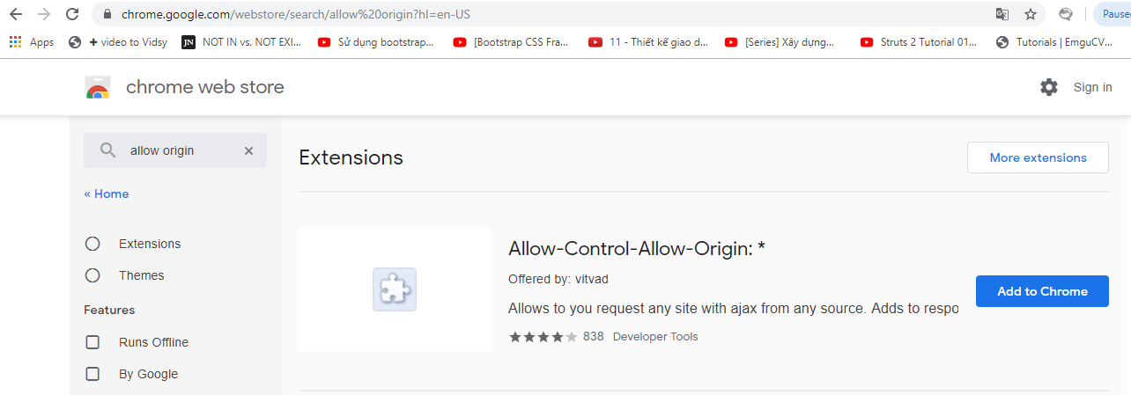
D I S A B L E W E B S E C U R I T Y
Install Chrome plugin
Allow-Control-Allow-Origin: *

Slide 5
U S I N G T H E M O V I E D B . O R G
Documentation: docs.themoviedb.apiary.io

Slide 6
I N S TA L L P O S T M A N
http://getpostman.com

Slide 7

G E T D ATA F R O M A P I
src/app/home/home.service.ts
Copy this key
import { Injectable } from '@angular/core';
import { HttpClient } from '@angular/common/http'
@Injectable({
providedIn: 'root'
})
export class HomeService {
private popularMoviesURL = "http://api.themoviedb.org/3/movie/popular?api_key=4aa883f95999ec813b8bfaf319f3972b";
constructor(private http: HttpClient) { }
getPopularMovies(){
return this.http.get<any>(this.popularMoviesURL);
}
}

Slide 8

G E T D ATA F R O M A P I
Copy this key
In src/app/app.module.ts
We use GET method for getting data
import { HttpClientModule } from '@angular/common/http';
@NgModule({
declarations: [AppComponent],
entryComponents: [],
imports: [BrowserModule, IonicModule.forRoot(), AppRoutingModule, HttpClientModule],
providers: [
StatusBar,
SplashScreen,
{ provide: RouteReuseStrategy, useClass: IonicRouteStrategy }
],
bootstrap: [AppComponent]
})
export class AppModule {}
API URL

Slide 9


M O V I E S E R V I C E
src/app/home/home.page.ts
constructor(private homeService:homeService){
this.getFilmData();
}
getFilmData(){
this.homeService.getPopularMovies().subscribe((res: any) => {
this. listFilms = res.results;;
console.log(res);
})
}
Method for getting popular movies
Request object which defines method, URL, headers etc.

Slide 10

M O V I E S E R V I C E
import { Injectable } from '@angular/core';
import { HttpClient } from '@angular/common/http'
@Injectable({
providedIn: 'root'
})
export class HomeService {
private popularMoviesURL = "http://api.themoviedb.org/3/movie/popular?api_key=4aa883f95999ec813b8bfaf319f3972b";
constructor(private http: HttpClient) { }
getPopularMovies(){
return this.http.get<any>(this.popularMoviesURL);
}
}
HTTP request

Slide 11

M O V I E S E R V I C E
Success callback Defines what happens after getting data

Slide 12

M O V I E S E R V I C E
constructor(private homeService:homeService){
this.getFilmData();
}
getFilmData(){
this.homeService.getPopularMovies().subscribe((res: any) => {
this. listFilms = res.results;;
console.log(res);
})
}
“response” is what we get from server

Slide 13

M O V I E S E R V I C E
constructor(private homeService:homeService){
this.getFilmData();
}
getFilmData(){
this.homeService.getPopularMovies().subscribe(
(res: any) => {
this. listFilms = res.results;;
console.log(res);
})
}
Save “results” to our “listFilms”

Slide 14

M O V I E S E R V I C E
constructor(private homeService:homeService){
this.getFilmData();
}
getFilmData(){
this.homeService.getPopularMovies().subscribe(
(res: any) => {
this. listFilms = res.results;;
console.log(res);
}),
error => {
console.log(error);
}
}
Error callback Defines what happens if we don’t get data

Slide 15

M O V I E S E R V I C E
constructor(private homeService:homeService){
this.getFilmData();
}
getFilmData(){
this.homeService.getPopularMovies().subscribe(
(res: any) => {
this. listFilms = res.results;;
console.log(res);
}),
error => {
console.log(error);
}
}
Call function

Slide 16
G E T T I N G M O V I E B Y I D
www/model/movies-service.js
service.getMovieById = function (id) {
var selectedMovie = {}; angular.forEach(service.data.movies, function (movie) {
if (movie.id == id) selectedMovie = movie;
});
return selectedMovie;
};

Slide 17

G E T T I N G M O V I E B Y I D
www/model/movies-service.js
service.getMovieById = function (id) {
var selectedMovie = {}; angular.forEach(service.data.movies, function (movie) {
if (movie.id == id) selectedMovie = movie;
});
return selectedMovie;
};
Simple foreach for searching by movie id

Slide 18
M O V I E D E TA I L

Slide 19
D E F I N I N G A P P S TAT E S
src/app/app-routing.ts
const routes: Routes = [
{ path: '', redirectTo: 'home', pathMatch: 'full' },
{ path: 'home', loadChildren: () => import('./home/home.module').then( m => m.HomePageModule)},
{ path: 'film-page', loadChildren: './film-page/film-page.module#FilmPagePageModule' },
];

Slide 20
P R E PA R E
Create files by CLI
ionic generate page filmPage
<script src="views/movies/movies-detail.js"></script>

Slide 21
C R E AT I N G M O V I E D E TA I L
src/app/home/home.page.ts
import { Router } from '@angular/router';
...
constructor(private router: Router, private homeService: HomeService) {
this.getFilmData();
}
...
showDetail(movie){
//movie la 1 object
this.router.navigate(['/film-page', movie]);
}

Slide 22

C R E AT I N G M O V I E D E TA I L
src/app/film-page/film-page.page.ts
import { ActivatedRoute } from '@angular/router';
...
constructor(private route: ActivatedRoute) { }
ngOnInit() {
this.route.params.subscribe(data=>{
console.log(data);
})
}
$stateParams gives URL params
Example: $stateParams.id: /movies/123 gives “123”

Slide 23
C R E AT I N G M O V I E D E TA I L
src/app/film-page/film-page.page.html
import { ActivatedRoute } from '@angular/router';
...
constructor(private route: ActivatedRoute) { }
ngOnInit() {
this.route.params.subscribe(data=>{
console.log(data);
})
}
$stateParams gives URL params
Example: $stateParams.id: /movies/123 gives “123”

Slide 24
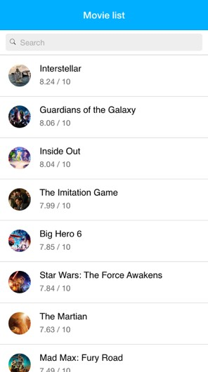
Y O U S H O U L D S E E T H I S

Slide 25

A N D I F W E C L I C K O N “ I N T E R S T E L L A R ”

Slide 26
M A R K M O V I E A S W AT C H E D

Slide 27
M A R K M O V I E A S W AT C H E D
We will use Local Storage (not the best choice)
Add button in Movie detail

Slide 28
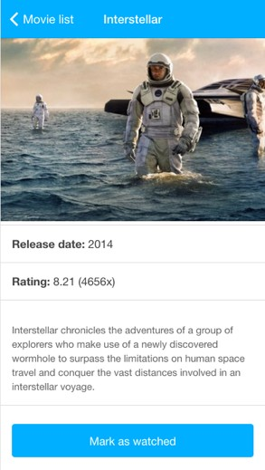
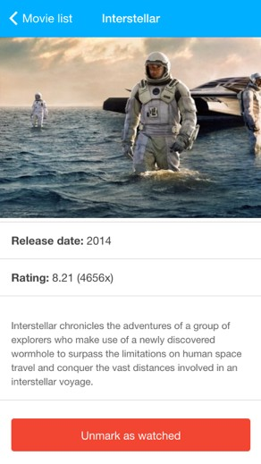
E X P E C T E D R E S U LT

Slide 29
G E T W AT C H E D M O V I E S A F T E R L O A D M O V I E S
www/model/movies-service.js
service.getMovies = function (callback) {
var req = {
method: "GET",
url: APP_CONFIG.getApiUrl("moviesPopular")
};
$http(req).success(function (response) { service.data.movies = response.results; if (callback) callback();
}).error(function (data, status, headers, config) { console.error("error");
});
};
service.getMovies(function(){ service.getWatchedMoviesFromStorage();
});

Slide 30

G E T W AT C H E D M O V I E S A F T E R L O A D M O V I E S
www/model/movies-service.js
service.getMovies = function (callback) {
var req = {
method: "GET",
url: APP_CONFIG.getApiUrl("moviesPopular")
};
$http(req).success(function (response) { service.data.movies = response.results; if (callback) callback();
}).error(function (data, status, headers, config) { console.error("error");
});
};
service.getMovies(function(){ service.getWatchedMoviesFromStorage();
});
Call function in callback

Slide 31
G E T D ATA F R O M L O C A L S T O R A G E
www/model/movies-service.js
service.watchedMovies = []; service.getWatchedMoviesFromStorage = function () {
try {
service.watchedMovies = JSON.parse( localStorage.getItem("watched_movies")
) || [];
} catch (e) {
console.warn("Invalid JSON string")
}
return service.watchedMovies;
};

Slide 32

G E T D ATA F R O M L O C A L S T O R A G E
www/model/movies-service.js
service.watchedMovies = []; service.getWatchedMoviesFromStorage = function () {
try {
service.watchedMovies = JSON.parse( localStorage.getItem("watched_movies")
) || [];
} catch (e) {
console.warn("Invalid JSON string")
}
return service.watchedMovies;
};

Slide 33


G E T D ATA F R O M L O C A L S T O R A G E
www/model/movies-service.js
service.watchedMovies = []; service.getWatchedMoviesFromStorage = function () {
try {
service.watchedMovies = JSON.parse( localStorage.getItem("watched_movies")
) || [];
} catch (e) {
console.warn("Invalid JSON string")
}
return service.watchedMovies;
};
“Not everything is a JSON document“
– Old Chinese proverb

Slide 34

G E T D ATA F R O M L O C A L S T O R A G E
www/model/movies-service.js
service.watchedMovies = []; service.getWatchedMoviesFromStorage = function () {
try {
service.watchedMovies = JSON.parse( localStorage.getItem("watched_movies")
) || [];
} catch (e) {
console.warn("Invalid JSON string")
}
return service.watchedMovies;
};
Happens when JSON is not valid

Slide 35

G E T D ATA F R O M L O C A L S T O R A G E
www/model/movies-service.js
service.watchedMovies = []; service.getWatchedMoviesFromStorage = function () {
try {
service.watchedMovies = JSON.parse( localStorage.getItem("watched_movies")
) || [];
} catch (e) {
console.warn("Invalid JSON string")
}
return service.watchedMovies;
};
When JSON is empty returns empty array

Slide 36
T O G G L E B U T T O N
F O R W AT C H E D M O V I E S
www/model/movies-service.js
service.toggleWatched = function (id) {
var occurenceIndex = service.watchedMovies.indexOf(id);
if (~occurenceIndex) service.watchedMovies.splice(occurenceIndex, 1);
else
service.watchedMovies.push(+id); localStorage.setItem("watched_movies", JSON.stringify(
service.watchedMovies)
);
};

Slide 37

T O G G L E B U T T O N
F O R W AT C H E D M O V I E S
www/model/movies-service.js
service.toggleWatched = function (id) {
var occurenceIndex = service.watchedMovies.indexOf(id);
if (~occurenceIndex) service.watchedMovies.splice(occurenceIndex, 1);
else
service.watchedMovies.push(+id); localStorage.setItem("watched_movies", JSON.stringify(
service.watchedMovies)
);
};
If there is an occurrence remove item from storage and reverse

Slide 38
C H E C K I F M O V I E I S W AT C H E D
www/model/movies-service.js
service.isMovieWatched = function (movieId) {
return !!~service.watchedMovies.indexOf(movieId)
};

Slide 39
C H E C K I F M O V I E I S W AT C H E D
www/model/movies-service.js
service.isMovieWatched = function (movieId) {
return !!~service.watchedMovies.indexOf(movieId)
};
WTF?

Slide 40

C H E C K I F M O V I E I S W AT C H E D
www/model/movies-service.js
service.isMovieWatched = function (movieId) {
return !!~service.watchedMovies.indexOf(movieId)
};
Returns position of “id” in Array
or “-1” if not found

Slide 41

C H E C K I F M O V I E I S W AT C H E D
www/model/movies-service.js
service.isMovieWatched = function (movieId) {
return !!~service.watchedMovies.indexOf(movieId)
};
“!!~” ensures that function returns “true” if there is an occurrence or “false” if not

Slide 42
A D D B U T T O N T O M O V I E D E TA I L
www/views/movies/movies-detail.html
<ion-view title="{{movie.title}}" id="view-movies-detail">
<ion-content>
<img src="http://image.tmdb.org/t/p/w500/{{movie.backdrop_path}}" />
<ul class="list">
...
<li class="item">
<button class="button button-block"
ng-click="toggleWatched(movie.id)" ng-class="{
'button-positive': !isMovieWatched(), 'button-assertive': isMovieWatched()
}">
<span ng-if="!isMovieWatched()">Mark as watched</span>
<span ng-if="isMovieWatched()">Unmark as watched</span>
</button>
</li>
</ul>
</ion-content>
</ion-view>

Slide 43

A D D B U T T O N T O M O V I E D E TA I L
www/views/movies/movies-detail.html
<ion-view title="{{movie.title}}" id="view-movies-detail">
<ion-content>
<img src="http://image.tmdb.org/t/p/w500/{{movie.backdrop_path}}" />
<ul class="list">
...
<li class="item">
<button class="button button-block"
ng-click="toggleWatched(movie.id)" ng-class="{
'button-positive': !isMovieWatched(), 'button-assertive': isMovieWatched()
}">
<span ng-if="!isMovieWatched()">Mark as watched</span>
<span ng-if="isMovieWatched()">Unmark as watched</span>
</button>
</li>
</ul>
</ion-content>
</ion-view>
Call markAsWatched(movie.id) after click on button

Slide 44

A D D B U T T O N T O M O V I E D E TA I L
www/views/movies/movies-detail.html
<ion-view title="{{movie.title}}" id="view-movies-detail">
<ion-content>
<img src="http://image.tmdb.org/t/p/w500/{{movie.backdrop_path}}" />
<ul class="list">
...
<li class="item">
<button class="button button-block"
ng-click="toggleWatched(movie.id)" ng-class="{
'button-positive': !isMovieWatched(), 'button-assertive': isMovieWatched()
}">
<span ng-if="!isMovieWatched()">Mark as watched</span>
<span ng-if="isMovieWatched()">Unmark as watched</span>
</button>
</li>
</ul>
</ion-content>
</ion-view>
Add class “button-positive” when
!movieWatched and reverse

Slide 45
B I N D C L I C K O N B U T T O N
www/views/movies/movies-detail.js
app.controller('MoviesDetailCtrl', function ($scope, MoviesService,
$stateParams) {
if($stateParams){
var movieId = +$stateParams.id;
$scope.movie = MoviesService.getMovieById(movieId);
}
$scope.toggleWatched = function(){ MoviesService.toggleWatched(movieId);
};
$scope.isMovieWatched = function () {
return MoviesService.isMovieWatched(movieId);
};
})

Slide 46

B I N D C L I C K O N B U T T O N
www/views/movies/movies-detail.js
app.controller('MoviesDetailCtrl', function ($scope, MoviesService,
$stateParams) {
if($stateParams){
var movieId = +$stateParams.id;
$scope.movie = MoviesService.getMovieById(movieId);
}
$scope.toggleWatched = function(){ MoviesService.toggleWatched(movieId);
};
$scope.isMovieWatched = function () {
return MoviesService.isMovieWatched(movieId);
};
})
Bind click on button

Slide 47

B I N D C L I C K O N B U T T O N
www/views/movies/movies-detail.js
app.controller('MoviesDetailCtrl', function ($scope, MoviesService,
$stateParams) {
if($stateParams){
var movieId = +$stateParams.id;
$scope.movie = MoviesService.getMovieById(movieId);
}
$scope.toggleWatched = function(){ MoviesService.toggleWatched(movieId);
};
$scope.isMovieWatched = function () {
return MoviesService.isMovieWatched(movieId);
};
})
Check if movie with movieId is watched

Slide 48
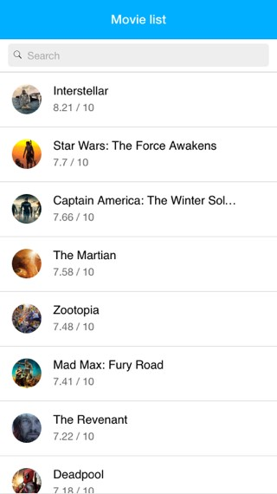
M O V I E L I S T

Slide 49
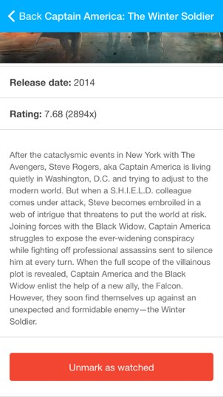
A F T E R C L I C K O N C A P TA I N A M E R I C A

Slide 50
Q U E S T I O N S ?

Slide 51
H O M E W O R K
Infinite scroll
http://bit.ly/1PDqUDU
http://ionicframework.com/docs/api/directive/ionInfiniteScroll/

Slide 52
JAN VÁCL AVÍK
@janvaclavik
DANIEL R YS
@danielrys
WW W.USER TECHNOLOGIES.COM

